Slide 1

Video Compression
Aniruddh Kumar Tiwari (MT24015)
Ashwini Chitturi(MT24021)
Jaya Shree Ketha(MT24042)
Priyotosh Saha(MT24068)

Slide 2
Index
Problem Statement
Data Preprocessing
Shot Bound Detection
Compression
Motion Vector (Optical flow)
Flow Chart

Slide 3
Problem Statement
Aim is to explore and implement video compression techniques that balance file size reduction and quality preservation. By combining scene change detection, DCT for spatial compression, and optical flow for frame interpolation, The ultimate goal is to develop an effective compression-decompression pipeline and identify challenges in achieving optimal results.

Slide 4


Data Preprocessing
Frame Extraction
Introduction to PySceneDetect
Scene Detection Using PySceneDetect
Content:
PySceneDetect is a Python library for automated video scene detection.
Detects scene boundaries based on changes in visual content.
Key Functions
How PySceneDetect Works
Content:
VideoManager: Manages video file input.
SceneManager: Detects and manages scenes.
Content Detector: Detects scene changes based on frame content (e.g., pixel intensity).
Summary
Why Use PySceneDetect?
Content:
Efficient scene detection.
Useful for video summarization, content analysis, or video editing.
Easy to integrate with other libraries like OpenCV.

Slide 5
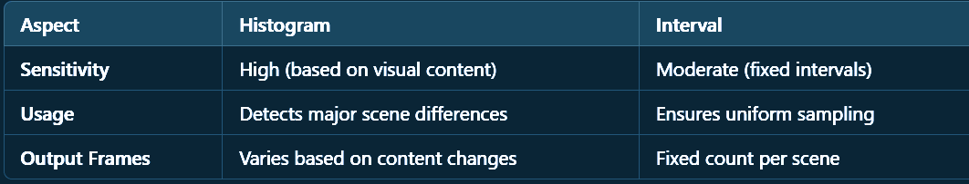
Shot Bound Detection
Histogram-Based Keyframe Selection
Keyframe Extraction via Histogram Differences
Content:
Objective: Identify significant visual changes.
Process:
Compute histograms for consecutive frames.
Compare histograms using correlation or chi-square difference.
Save frame if histogram difference exceeds a threshold.
Key Advantage:
Captures subtle visual changes.
Interval-Based Keyframe Selection
Keyframe Extraction via Fixed Intervals
Content:
Objective: Uniform sampling of keyframes.
Process:
Calculate frame interval based on scene length.
Save frames at regular intervals.
Key Advantage:
Ensures consistent number of keyframes per scene.

Slide 6


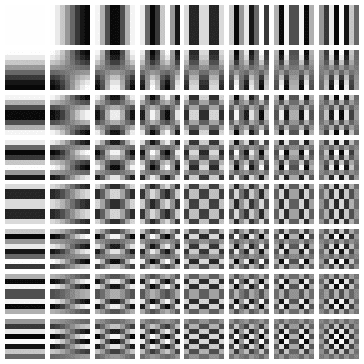
Compression
Temporal compression involves extracting key frames to reduce redundancy between frames in a video sequence.
Spatial compression focuses on compressing spatially redundant data within keyframes by applying DCT. DCT Transform Wave https://youtu.be/Q2aEzeMDHMA?si=xAn_9IzrdJ4Kr8Sb
Compressed
Orginal
DeCompressed

Slide 7
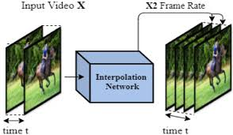
Motion Vector (Optical flow)
Optical flow computes motion vectors for every pixel in the frame, estimating how the intensity of pixels moves between frames.
interpolation techniques are applied to generate intermediate frames between keyframes, providing smooth transitions and reducing the need for storing every frame in the video.
Challenges - we need to provide correct frame rate so that the video runs without any disturbances
InterPolation

Slide 8
Start
Flow Chart
Original video
KeyFrame
Detected
DCT & IDCT
Reconstruct frames
Recombined video
Recombined video
Start

